Slide 1
DevOps
Notes:
https://courses.cs.washington.edu/courses/cse403/13au/lectures/git.ppt.pdf
http://enos.itcollege.ee/~jpoial/allalaadimised/git/getting-started-with-git.pdf

Slide 2
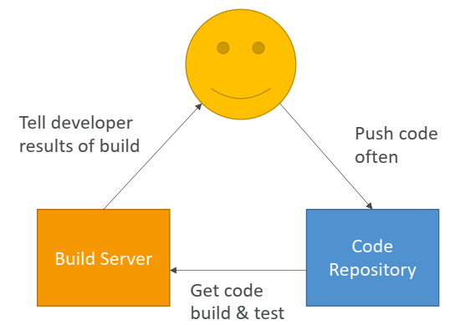
AWS CICD

Slide 3
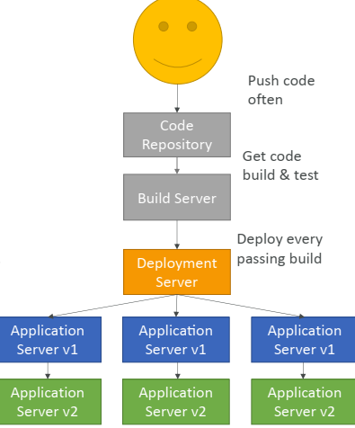
Continuous Delivery

Slide 4
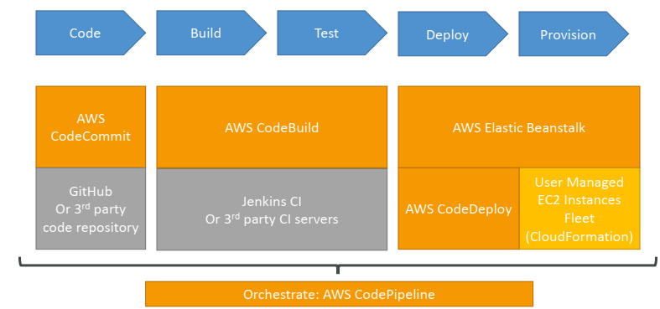
Technology Stack for CICD

Slide 5
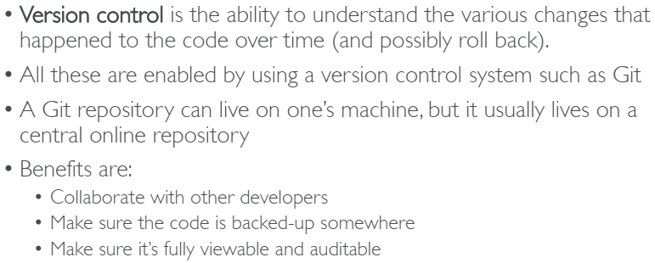
CodeCommit

Slide 6
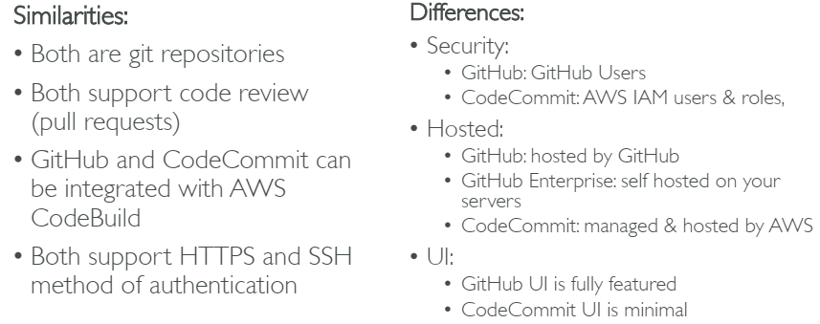
CodeCommit vs GitHub

Slide 7
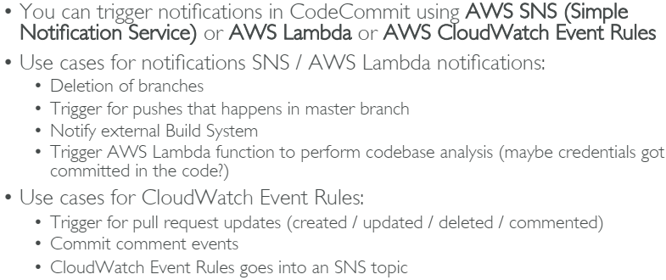
CodeCommit Notifications

Slide 8
CodePipeline
Continuous delivery
Visual workflow
Source: GitHub / CodeCommit / Amazon S3
Build: CodeBuild / Jenkins / etc…
Load Testing: 3rd party tools
Deploy: AWS CodeDeploy / Beanstalk / CloudFormation / ECS…
Made of stages:
Each stage can have sequential actions and / or parallel actions
Stages examples: Build / Test / Deploy / Load Test / etc…
Manual approval can be defined at any stage

Slide 9
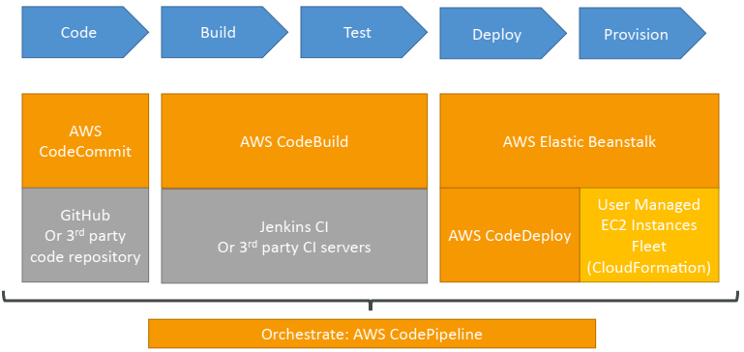
Technology Stack for CICD

Slide 10
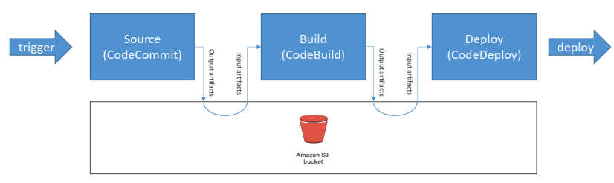
AWS CodePipeline Artifacts
Each pipeline stage can create ”artifacts”
Artifacts are passed stored in Amazon S3 and passed on to the next stage

Slide 11
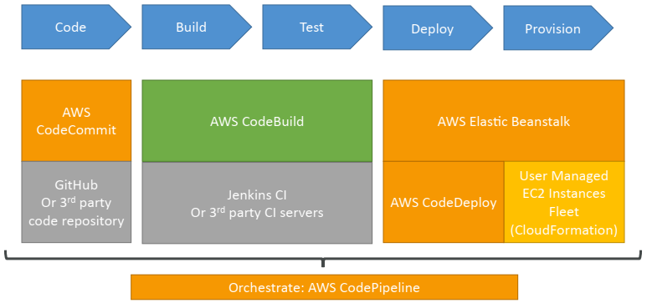
CodeBuild

Slide 12
CodeBuild Overview
Fully managed build service
Alternative to other build tools such as Jenkins
Pay for usage: the time it takes to complete the builds
Leverages Docker under the hood for reproducible builds
Source Code from GitHub / CodeCommit / CodePipeline / S3…
Output logs to Amazon S3 & AWS CloudWatch Logs
Use CloudWatch Events to detect failed builds and trigger notifications
Use CloudWatch Alarms to notify if you need “thresholds” for failures

Slide 13
CodeBuild Support environments
Java
Ruby
Python
Go
Node.js
Android
.NET Core
PHP
Docker: extend any environment you like

Slide 14
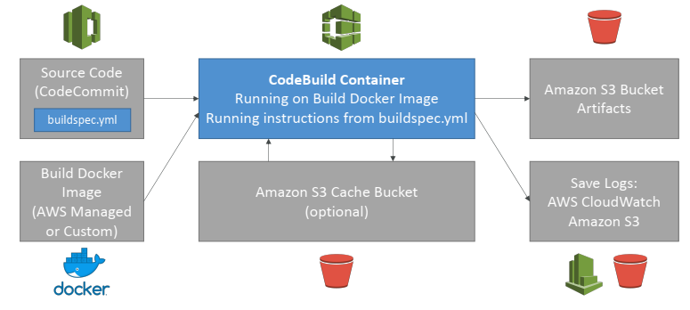
How CodeBuild works

Slide 15
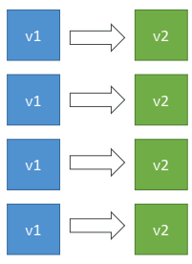
AWS CodeDeploy
We want to deploy our application automatically to many EC2 instances
These instances are not managed by Elastic Beanstalk
There are several ways to handle deployments using open source tools (Ansible, Terraform, Chef, Puppet, etc…)
We can use the managed Service AWS CodeDeploy

Slide 16
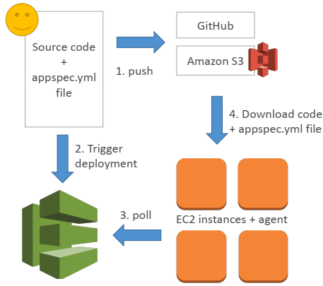
AWS CodeDeploy – Steps to make it work

Slide 17
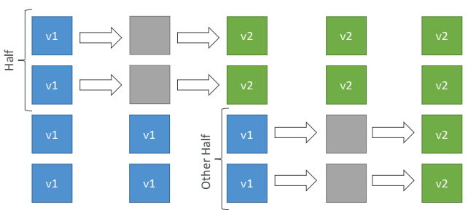
In Place Deployment – Half at a time

Slide 18
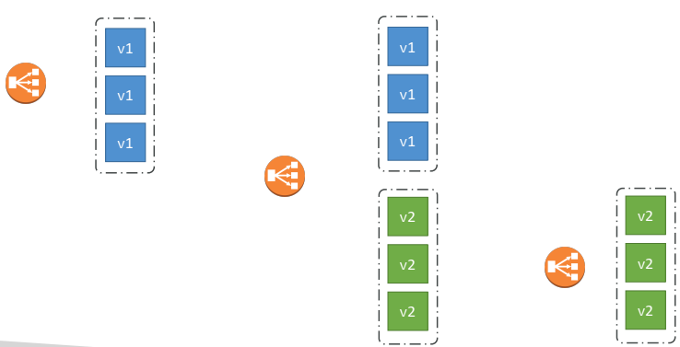
Blue Green Deployment

Slide 19
CodeDeploy - roll backs
You can specify automated rollback options
Roll back when a deployment fails
Roll back when alarm thresholds are met
Disable rollbacks — Do not perform rollbacks for this deployment.
If a roll back happens, CodeDeploy redeploys the last known good revision as a new deployment.

Slide 20
What is AWS OpsWorks?
A new service from Amazon
An integrated application management solution for Ops-minded developers and IT admins
It is a DevOps offered by Amazon
Based on Chef tool
A configuration management service
Helps to configure and operate applications in a cloud enterprise by using Chef.

Slide 21
What is AWS OpsWorks?
You can have full control over the
OS,
Instance count and
Make changes directly to the deployment mechanisms.

Slide 22
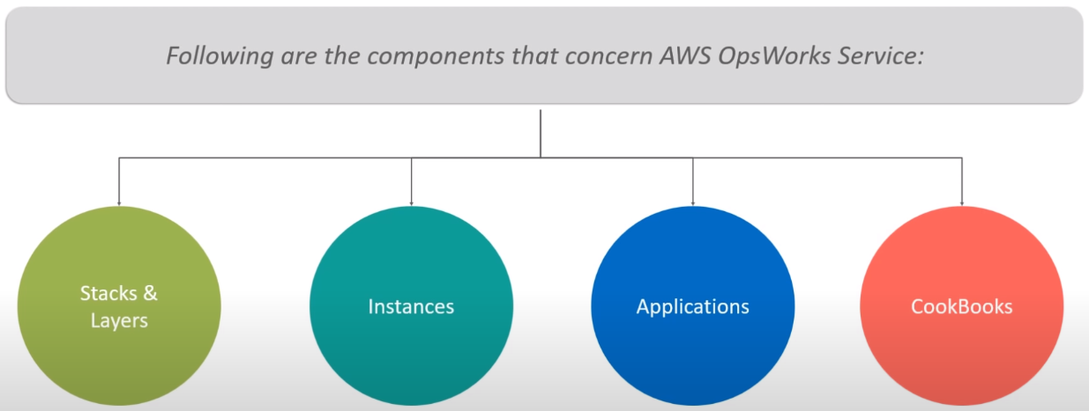
Components

Slide 23
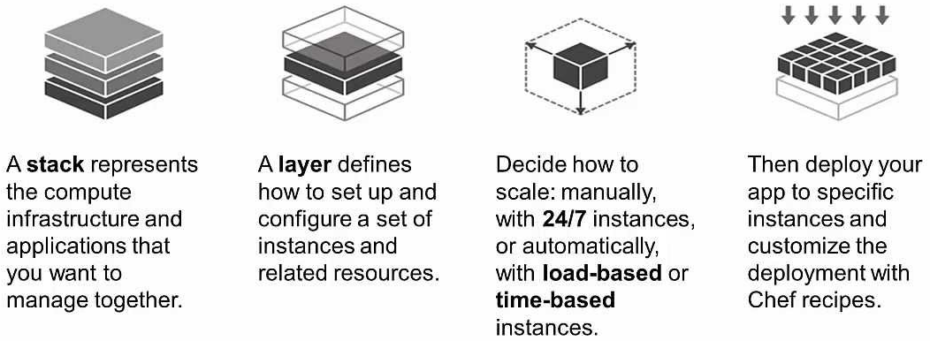
OpsWorks Structure

Slide 24
Thanks

